Slide 1
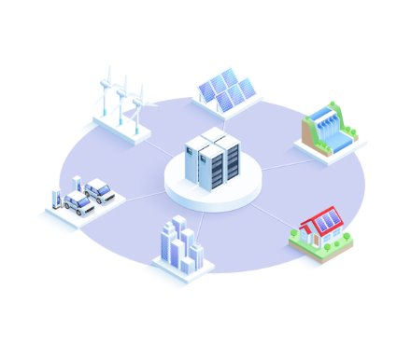
Problem Statement: Create a Microgrid on Mars!
Microgrids are localized grids designed to provide electricity to a small geographic area, such as a university campus, a hospital complex, or a business center, and are necessary for establishing permanent stations for space exploration.
They can function independently by using local energy generation sources, which often include renewable resources like solar panels, wind turbines, and energy storage systems like batteries.
As our engineers stationed on Mars, it's your job to develop a new microgrid system that will provide power to your station!

